Slide 1
Data Analysis of Online Traces

Slide 2
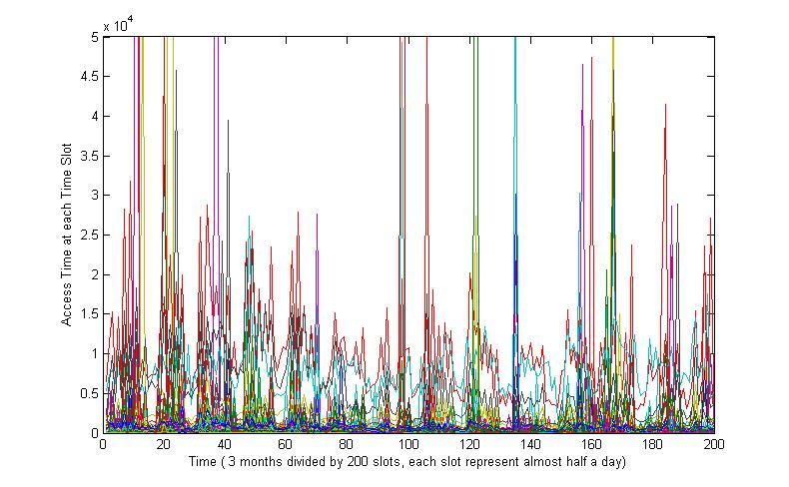
Access traces for 1700 files over 3 months

Slide 3
Some explanation
After looking at each file’s access pattern one by one, we figure out that most files can be put into two categories according to their access patterns:
Constant access patterns
Burst access patterns
Terminology:
Time slot: all the traces are 3 months long, and we divided the time into 200 slots, so each slot is almost half a day.
Access time: the access time is the total amount of access during each time slot.

Slide 4
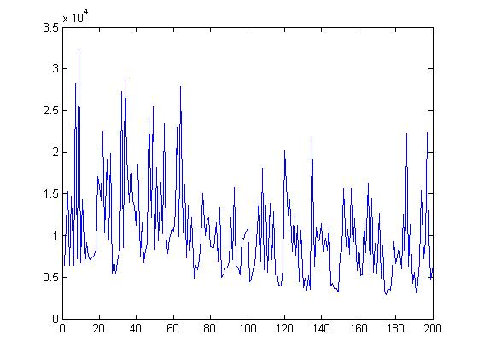
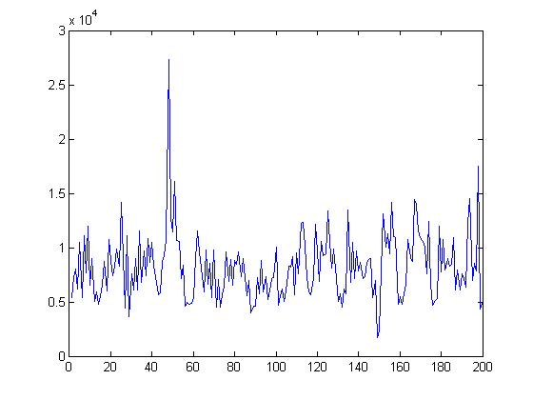
Constant Access Patterns
Below are two separate files that have constant access patterns: the access time at most time slot is above certain threshold (500) .
This is the worst case for using learning algorithm, since it has very limited improvement over simple greedy algorithm which will put an object into SSD when its access time is above a threshold.

Slide 5
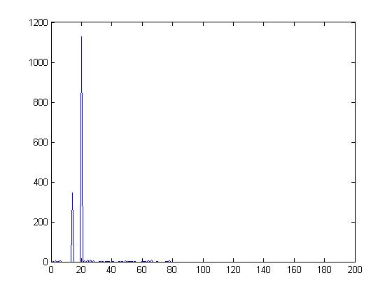
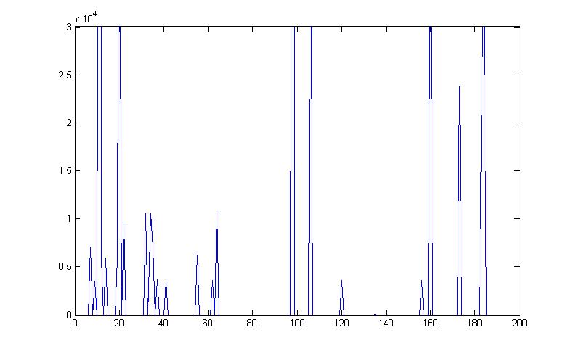
Burst Access Patterns
Below are two separate files that have burst access patterns: the access time at most time slot is almost 0 and there are very high access time at very few time slot.
Since such an access pattern has very limited time locality, it is very hard to predict when the burst access will happen. To use learning algorithm, we must use very small update interval, which will introduce very large overhead in terms of computation capability and internal network bandwidth..

Slide 6
Some Comments about Traces
These traces we use are from a scientific research projects. It is likely that each file was only accessed by very few users. This might be the reason for most burst access (arbitrary behavior of human). Files with constant access patterns are more likely to be common system files which will be used very often.
We have analyzed several online traces and they share similar access patterns.
Workloads such as youtube video, itunes music, facebook blogs may have different access pattern (since each file will be accessed by tons of peoples) that learning algorithms might be useful (NOT Sure).

